Slide 1


MACHINE LEARNING
Project
Adari Lohit – Ladari@kent.edu

Slide 2
Introduction
This data is all about bike demand with respect to climate, so as a rental company one of your concerns is customer satisfaction. Predicting bike rental demand helps the company to adjust the availability.
The big problem with the prediction is that it converges to the task of predicting weather.
To avoid the bad reputation on the rental service it is necessary to know the requirement based on the weather condition

Slide 3

Abstract
The project is about bike rental database.
Price differences based on weather conditions.
To do that we used EDA to understand the data

Slide 4
Methodology
The algorithm used for the dataset is kmean “elbow method” and “silhouette method”
And compare both the methods and forecast how accurate our algorithm is:
After knowing the number of cluster and the k value we will know the insights of the data.
Using prcomp we will be knowing the important factors effects the predictions.
Their variance, standard deviation and cumulative proportion.

Slide 5
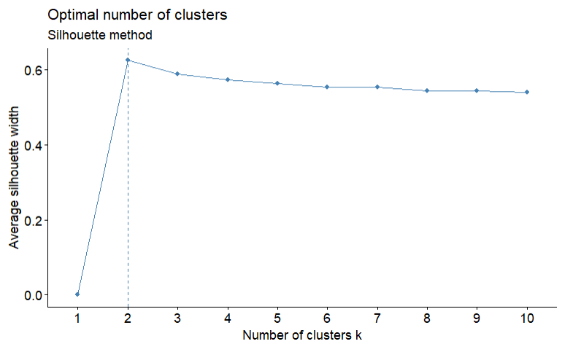
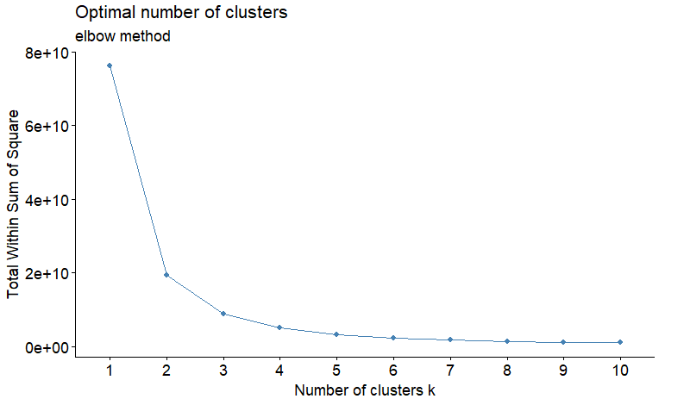
Algorithm
In both the methods the k value is 2
The range is usually (0,1) in elbow method and (-1,1) in silhouette method.
The point k=2 is near to 0 which is the peak point and from there it keeps on decreasing.

Slide 6
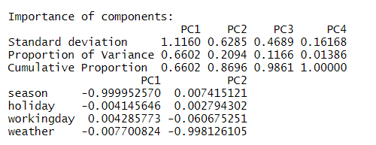
Conclusion
Bike rental prediction depends on weather condition, working day or a holiday and season
As a biker rental service provider, I should make sure season time and based on weather condition the I should meet the customers requirement, to not to lose customers

